Slide 1
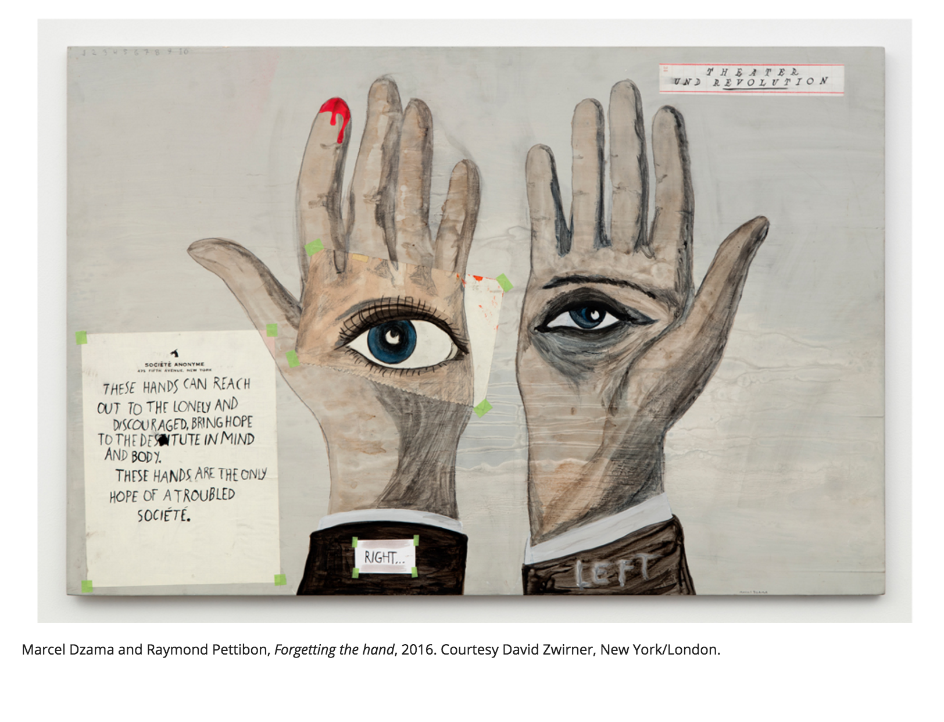
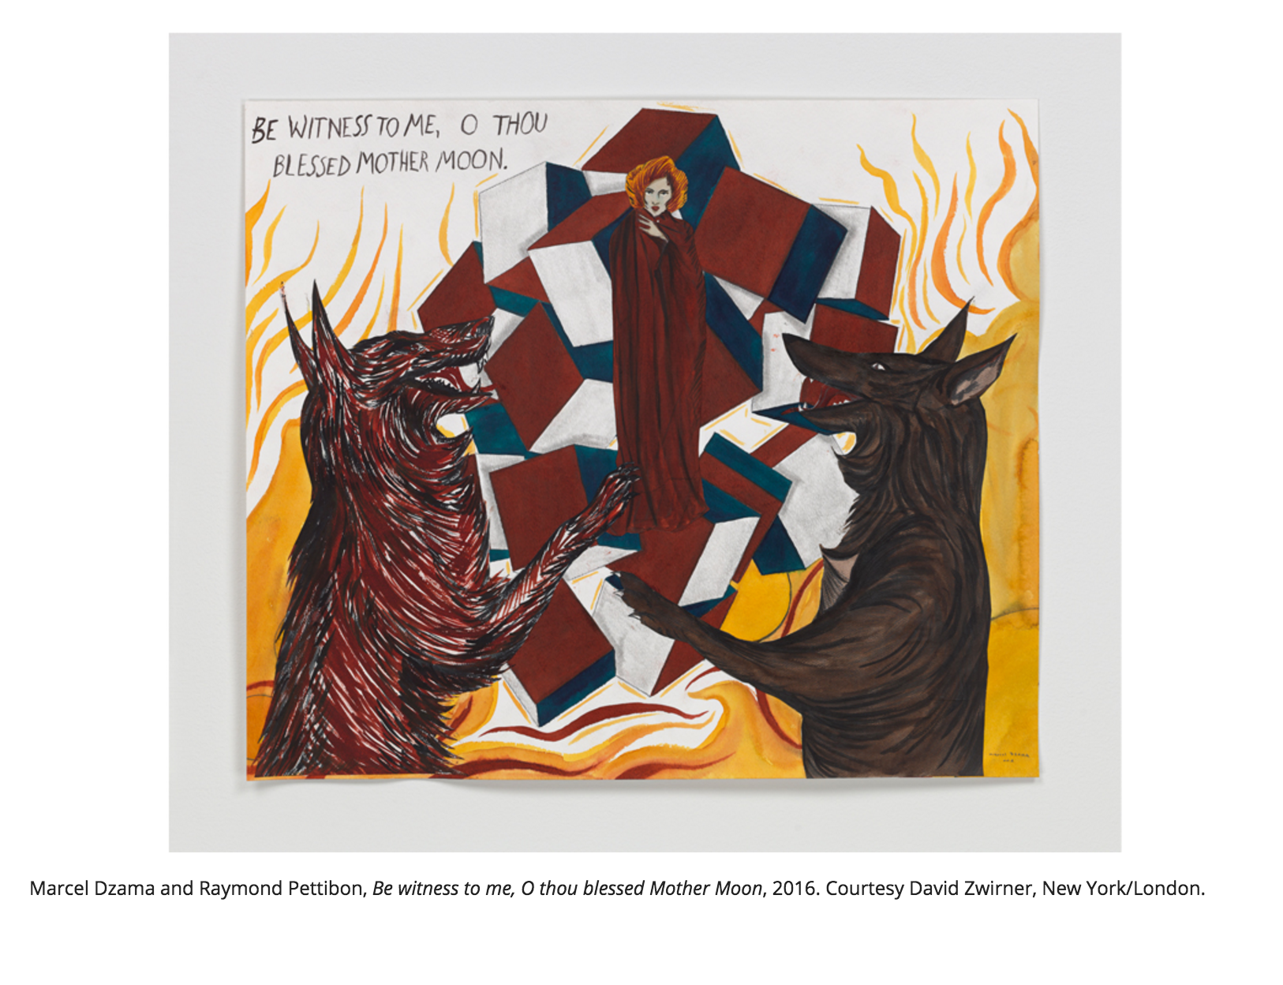
Forgetting the Hand (exquisite corpse)
Exquisite Corpse
Automatism
Marcel Dzama and Raymond Pettibon:
“Forgetting the Hand”
David Zwirner Gallery, New York, Jan 14 to Feb 20
At the opening for “Forgetting the Hand,” the Marcel Dzama and Raymond Pettibon show now on view at David Zwirner Gallery in New York, visitors squinted at the drawings tacked to the wall, trying to match the art with the artist…
As the title suggests, “Forgetting the Hand” is intended this way. We aren’t supposed to think about who drew or wrote or painted what. This is an elaborate game of exquisite corpse, passed back and forth between the artists until a collaborative conclusion is reached.
“Forgetting the Hand” was originally conceived as a zine between the two artists, of which a limited print run of 300 sold out…

Slide 2
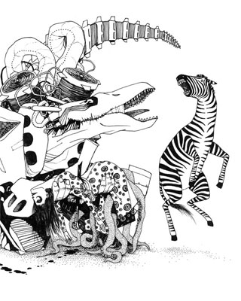
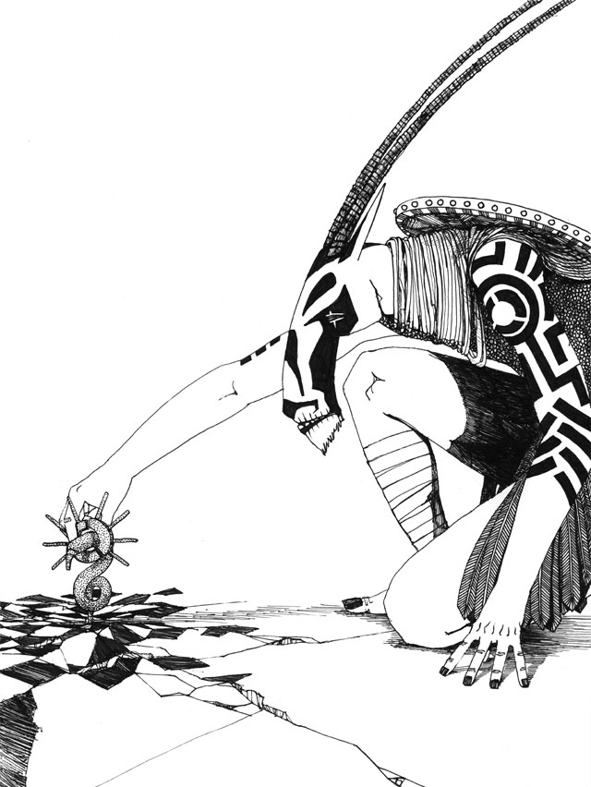
On the Road of Knives, A Collaborative Comic
“So this is how it works: Zak draws something. Shawn draws something that will fight it. Zak draws his thing fighting back. Shawn draws his thing fighting back and maybe tripping over a statue… Then Shawn draws a new thing. Zak's surviving thing attacks it. And so on…”

Slide 3
Kim Moodie
Departure (detail)
25.25 x 38.5 Inches (paper size), Lithograph

Slide 4
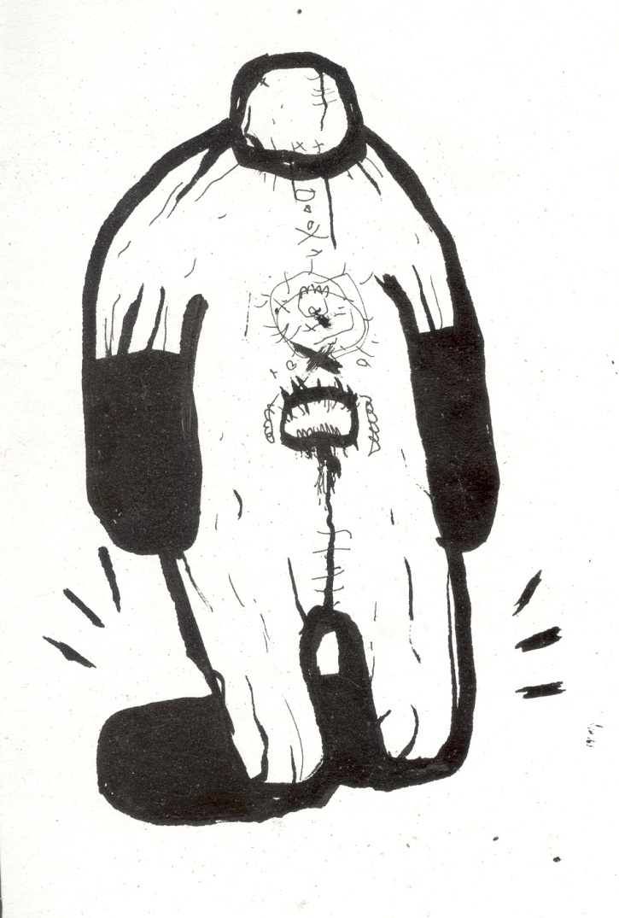
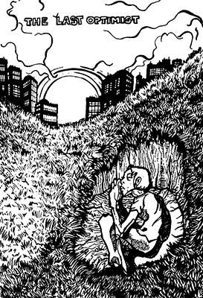
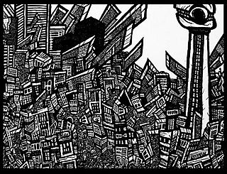
Mike Parsons
The Seeing Tower Watches over the City of Toronto. This 4 x 6 ft pen and ink artwork depicts the city of Toronto in all it's chaotic beauty. People propel the metropolis moving throug giant gears, while strange creatures,robots, and heroes attempt to co-exist. This drawing was a part of a set of 10 detailed drawings created between Oct -Dec. 2007, and was exhibited at the Resistor Gallery Dec 2007.

Slide 5
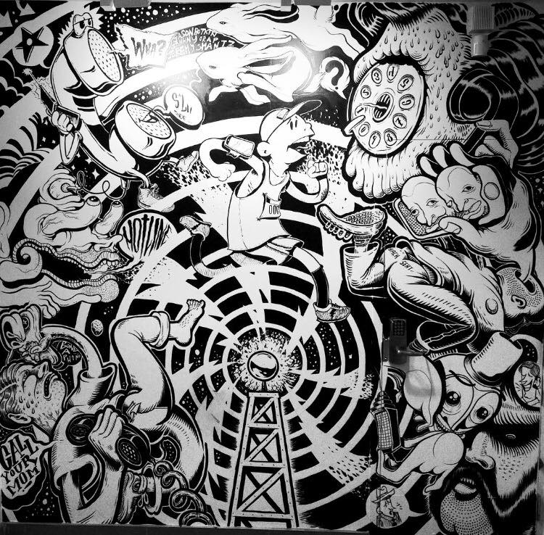
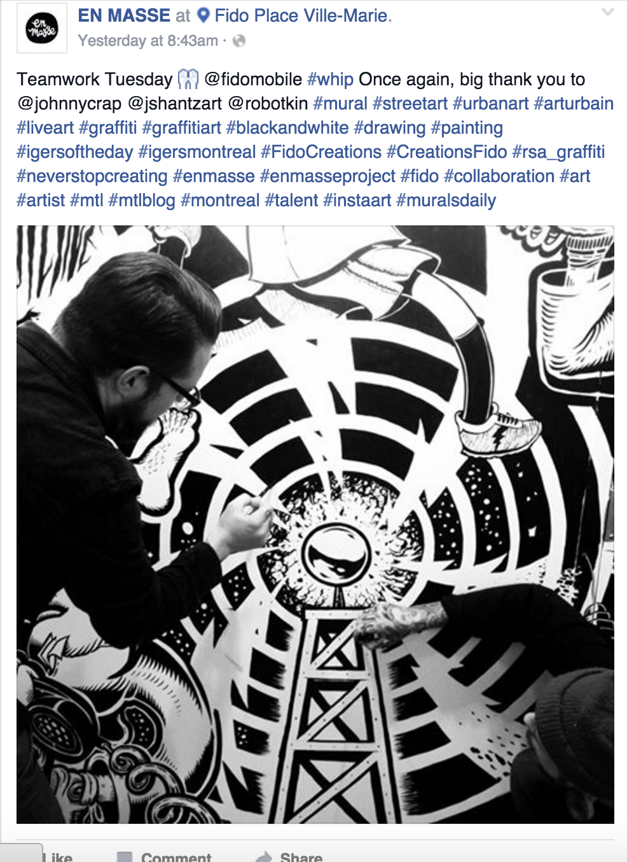
EN MASSE is an ongoing series of artistic conversations; a non-linear dialog connecting many artists through the creation of large-scale collaborative black and white drawings. The shape and character of each production is defined by those creators who take part in the project, and the energies they individually and collectively bring to the mix.
Under the direction of Jason Botkin, Rupert Bottenberg, and Valery LaJoie, EN MASSE brings together emerging artists drawn from the diverse fields of the ‘high’ and ‘low’ brow arts, including graffiti, alternative comics, and illustration.

Slide 6
Posada’s best known works are his calaveras, or skeletons, which were often seen performing the rituals and pleasures of everyday life and assume various costumes, such as the Calavera de la Catrina, the “Skeleton of the Female Dandy”, which was meant to satirize the life of the upper classes. (Satirize: to make fun of)

Slide 7
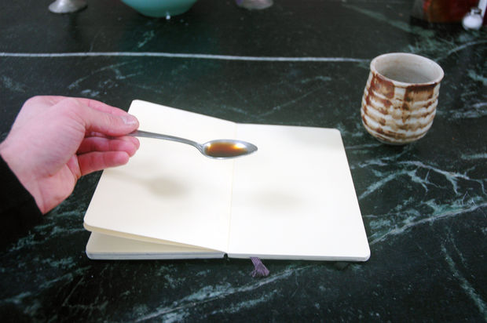
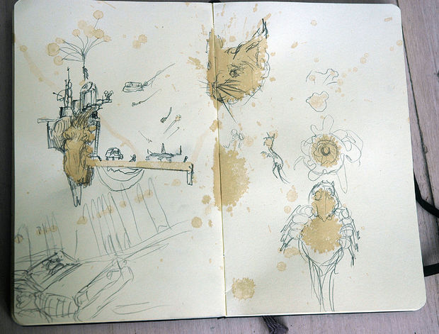
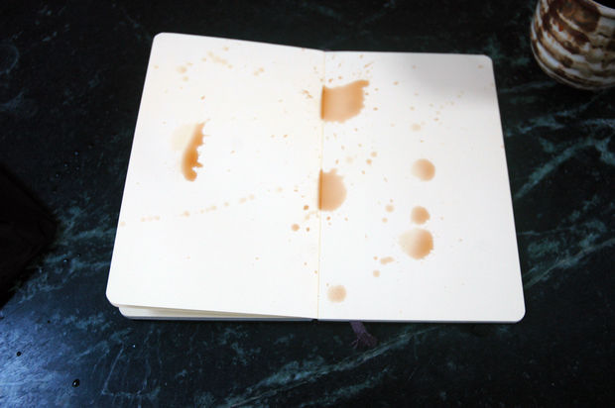
Art Warm up Exercises
Just look at your little splashes and streaks and think of what they look like.
http://www.instructables.com/id/Great-Artist-Warm-Up-Exercise/step3/Sip-and-Draw/

Slide 8
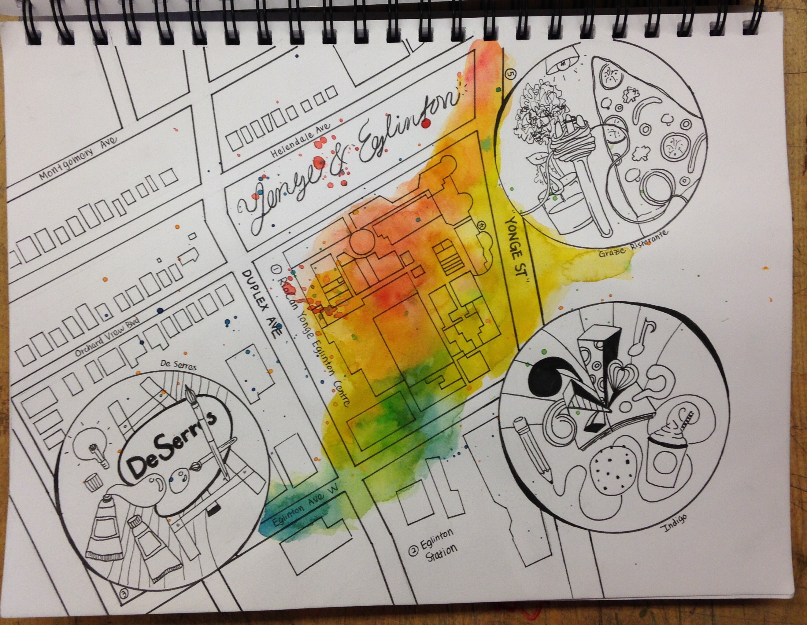
You should include light pencil colours or coloured washes on your sketchbook page to create some visual attention and interest in areas of the background.

Slide 9
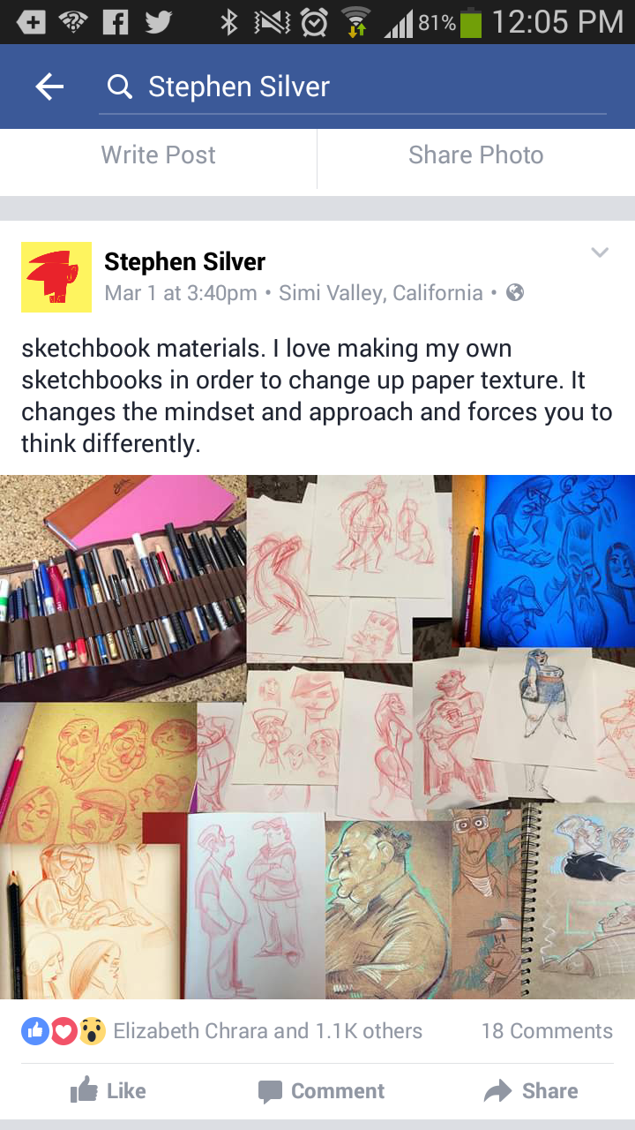
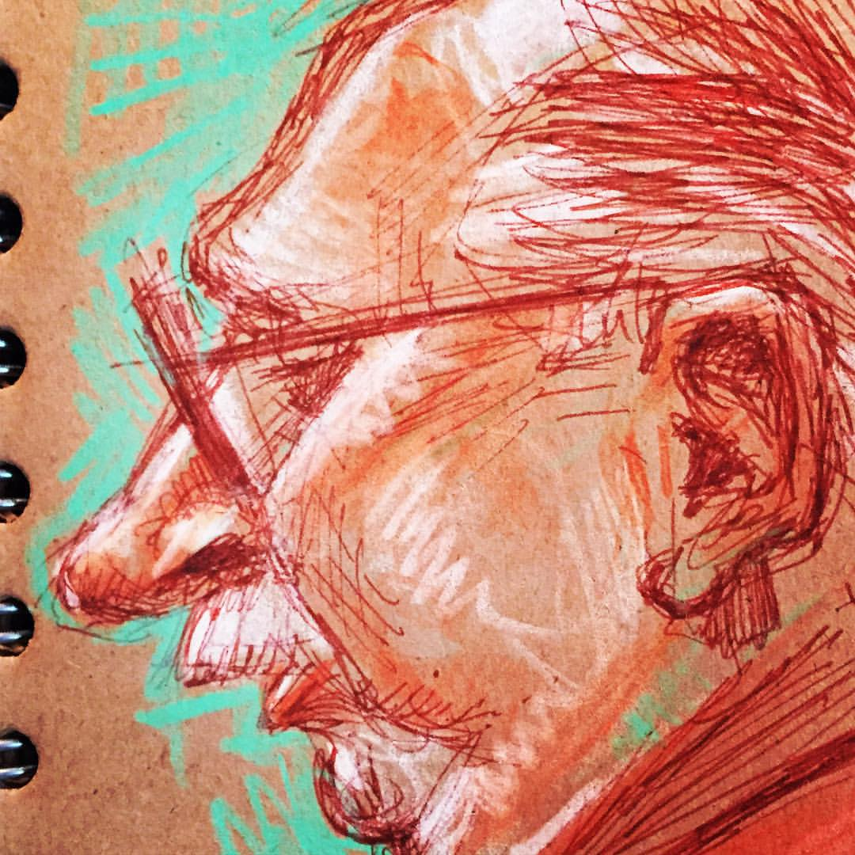
Brown ink, brown paper and some colored pencils.

Slide 10
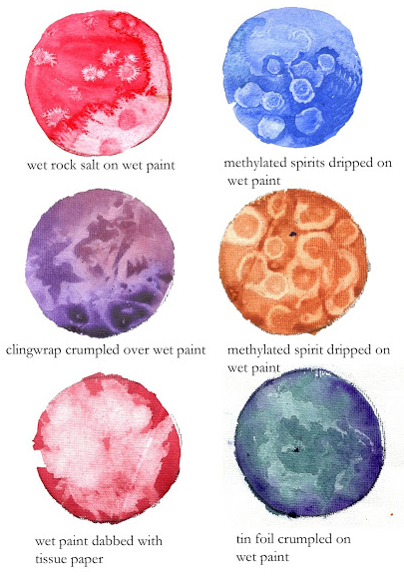
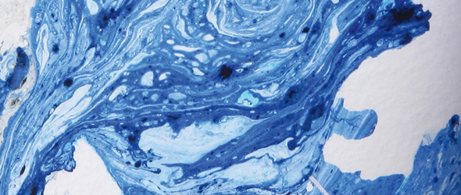
Watercolour Experiments
Linda E Clarke Illustration
Experimental Watercolour Effects
http://www.artistsandillustrators.co.uk/how-to/abstract/241/experimental-watercolour-effects
Tutor Jo Lewis explains an alternative way of masking out and some unusual uses for clingfilm﻿.
Notes:
http://lindaeclarke.blogspot.ca/2013/05/watercolour-experiments.html

Slide 11
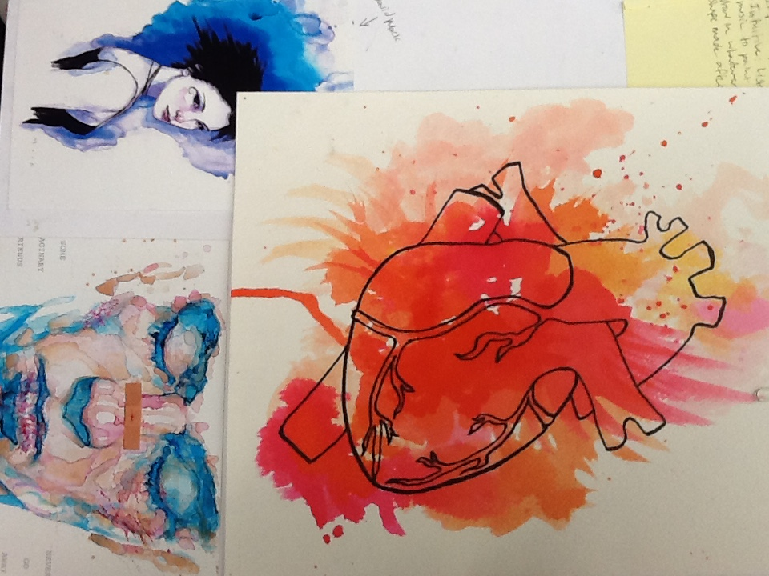
Student work inspired by David Mack

Slide 12
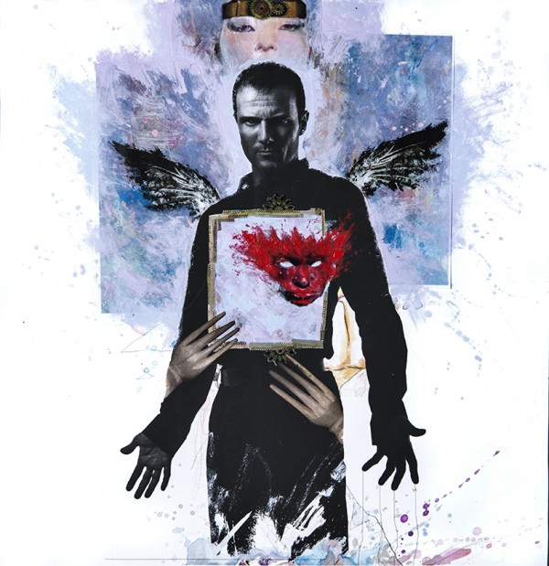
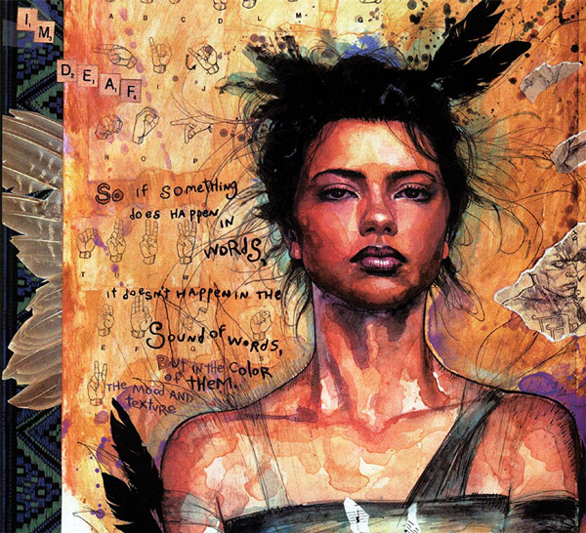
FRIDAY & MONDAY – FINAL SKETCHBOOK EXPERIMENTS (combining mixed-media/notes/ideas), SKETCHBOOK DISPLAY & DECIDE ON HOW YOU WILL START FINAL.
e.g.a hand drawing, an abstract hand, sign language, forms, shapes, large small, with a splash of colour, a wash, pencil –shaded, pen/ink, paint…
DAVID MACK >>>>>>
Media: pen/ink, watercolour & paint
Sometimes incorporates photos/magazine and sometimes uses text
TUESDAY – START GROUP “FORGETTING THE HAND”

Slide 13
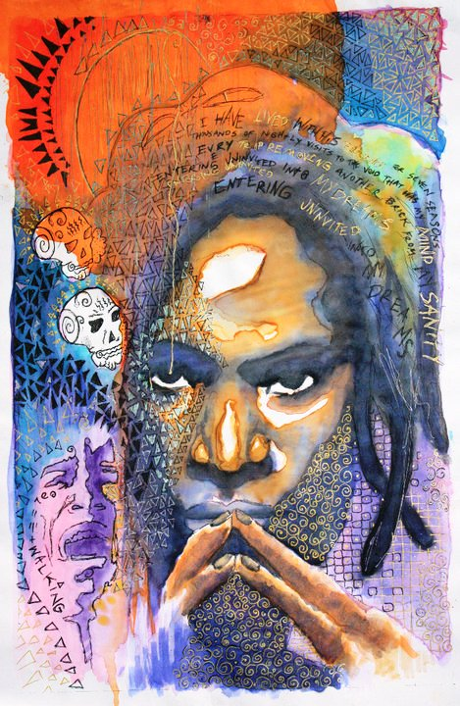
David Mack

Slide 14
Investigating modern art book
Automatism p. 95-7 / 99/ 118/ 173
Exquisite Corpse p. 93, 104
Automatism p. 95-7
Surrealism claimed to be oppossed to reason, while at the same time rationalized actions using definitions:
Surrealism, n. Psychic automatism in its pure state, by which one proposes to express – verbally, by means of the written word, or in any other manner – the actual functioning of thought. Dictated by thought, in the absence of any control by reason, exempt from any aesthetic or moral concern

Slide 15
Automatism, technique first used by Surrealist painters and poets to express the creative force of the unconscious in art.
In the 1920s the Surrealist poets André Breton, Paul Éluard, Robert Desnos, Louis Aragon, and Philippe Soupault tried writing in a hypnotic or trancelike state, recording their train of mental associations without censorship or attempts at formal exposition. These poets were influenced by Freudian psychoanalytic theory and believed that the symbols and images thus produced, though appearing strange or incongruous to the conscious mind, actually constituted a record of a person’s unconscious psychic forces and hence possessed an innate artistic significance. Little of lasting value remains from the Surrealists’ attempts at “automatic” writing, however.
Automatism was a more productive vehicle for the Surrealist painters. André Masson, Arshile Gorky, and Max Ernst, in particular, experimented with fantastic or erotic images that were spontaneously recorded in a kind of visual free association, without the artist’s conscious censorship; the images were then either left as originally conceived or were consciously elaborated upon by the artist. Related to automatic drawing are the techniques Ernst devised to involve chance in the creation of a picture. Among them were “frottage,” placing canvas or paper over different materials such as wood and rubbing it with graphite to make an impression of the grain; “grattage,” scratching the painted surface of the canvas with pointed tools to make it more tactile; and “decalcomania,” pressing liquid paint between two canvases and then pulling the canvases apart to produce ridges and bubbles of pigment. The chance forms created by these techniques were then allowed to stand as incomplete, suggestive images, or they were completed by the artist according to his instinctive response to them.
Between 1946 and 1951 a group of Canadian painters—including Paul-Émile Borduas, Albert Dumouchel, Jean Paul Mousseau, and Jean-Paul Riopelle—known as Les Automatistes, practiced automatism. From about 1950 a group of artists in the United States called Action painters adopted automatic methods, some under the direct influence of Masson, Gorky, and Ernst, all of whom had moved to the United States to escape World War II. Seeking abstract pictorial equivalents for states of mind, painters Jackson Pollock, Willem de Kooning, Franz Kline, Jack Tworkov, and Bradley Walker Tomlin variously experimented with chance drippings of paint on the canvas and free, spontaneous brushstrokes. This approach was seen as a means to strip away artifice and unlock basic creative instincts deep within the artist’s personality. Automatism has since become a part of the technical repertoire of modern painting, though its prominence declined with that of Action painting itself.

