Slide 1
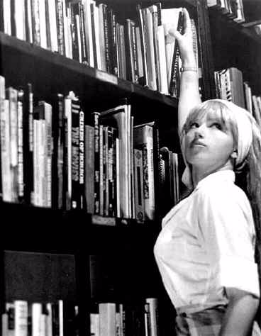
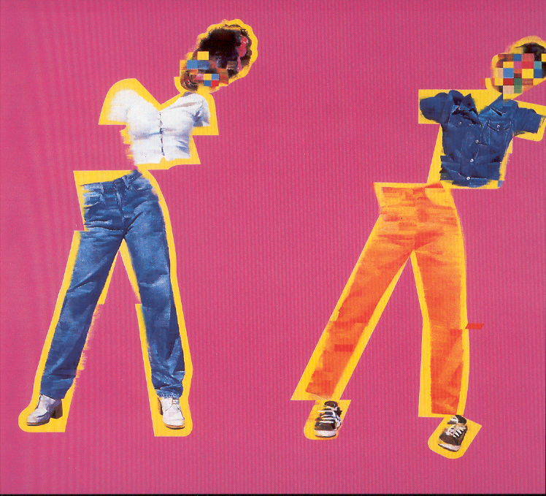
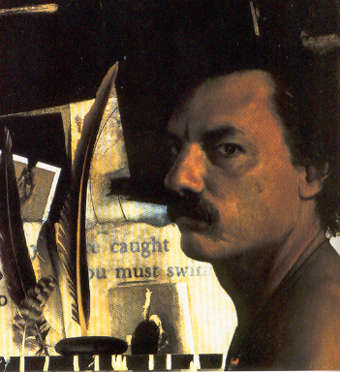
CONTEMPORARY

Slide 2
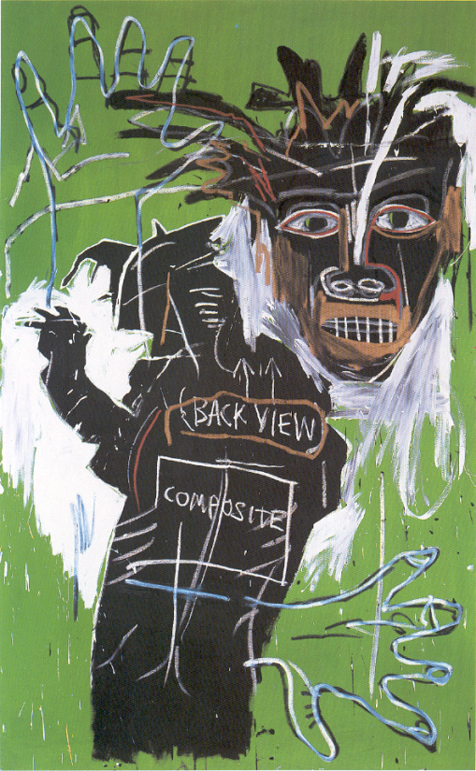
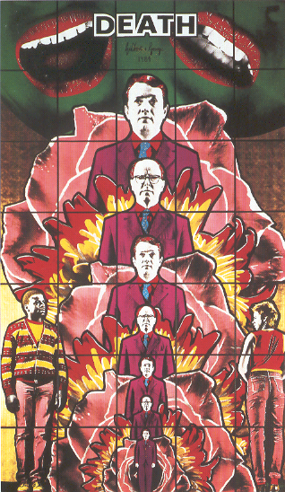
CONTEMPORARY
Contemporary art is artwork which is currently being produced by living artist. It is often concerned with contemporary issues and can take many forms.
Refer back to the previous sections.
Q) What are the similarities to expressionism?
Q) How are Contemporary portraits different from traditional paintings?
Q) How has the portrait been developed?

Slide 3
‘Self-Portrait’
Richard Shaffer
1993
Oil on canvas
Shaffer is part of the Realist movement within American art. Notice how he has refined the feathers and also experimented with trompe l’oeil. The use of this technique refers to an early twentieth century artist called William Harnett.

Slide 4
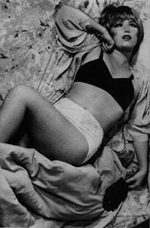
CINDY SHERMAN
Cindy Sherman is a photographer, but not in the traditional sense of the word. Not only is she the person behind the lens of the camera, but she also puts herself in front of the lens, as the model and subject of her photographs. Although she photographs herself, however, her images are not self-portraits. The artist wears masks, costumes, and uses mannequin parts and props to create different identities. In her words, she is "trying to make other people recognise something of themselves rather than me." As a result, her work deftly investigates how people, and how women in particular, create their own self-image.
Q) How do clothes portray a persons identity?
Q) What clothes identify you?

Slide 5
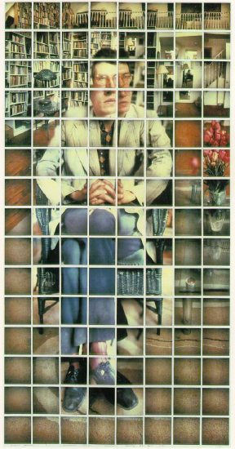
‘David Graves’
David Hockney
1982
Composite Polaroid
Hockney is more widely regarded for his paintings, although he has achieved successful compositions with the use of a camera. Here he has used a Polaroid camera but how with today's technology could you achieve a similar effect?
Use a camera to capture your own or another persons appearance.

Slide 6
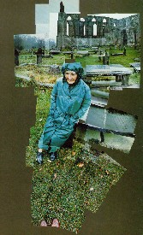
‘My Mother, Bolton Abbey, Yorkshire’
David Hockney
1982
Photographic Collage
Look at the composition of this picture.
Q) How has he captured the fragility of his mother?
Q) Why did he only display part of the surroundings?
Q) Does the use of photography reduce the expressive qualities of the portrait?

Slide 7
‘Dis-colate’
Justin Mortimer
1997
Oil on Linen
The artist aims to capture an emotion or his own response to and feelings about the sitter, rather than an accurate likeness of the subject.
The introduction of geometric shapes and unexpected colours to portraits gives a disturbing quality to the surface of the paint.
Experiment with digital media or cut up pictures of yourself and rearrange.

Slide 8
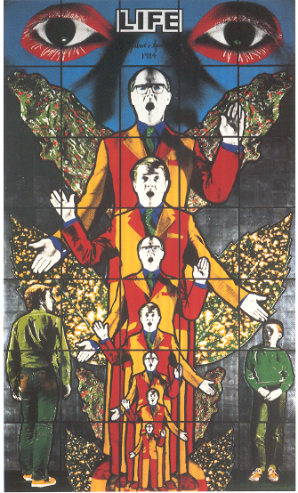
Gilbert and George
1984
Hand coloured
Photograph
Gilbert and George met while students at St Martin’s College. In 1970 they proclaimed themselves ‘living sculptures’ and have consistently used their distinctive, besuited figures as the raw material for their art since that time. Since the 1980’s their dominant form has been monumental structures. The heroic scale and directness of the work, and the apparent seriousness of their themes, link their them to the tradition of pictorial storytelling.
‘Life’
‘Death’
Q) How does it make you feel, are they mocking life or death?
Q) How does this compare to stained glass we see in churches?

Slide 9
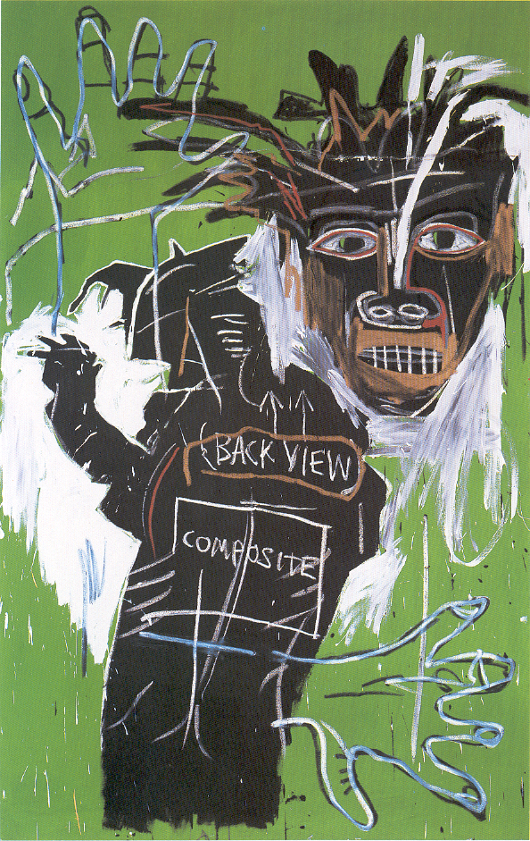
‘Self-Portrait as a Heel, PartTwo’
Jean-Michel Basquiat
1982
Acrylic and oil paintstick on canvas
Basquiat was a prolific artist within America during the 1980s. At the start of the 80’s Basquiat was living rough on the street, he used this as inspiration for these early pieces of work. He absorbed imagery from the streets, the newspapers and television. His style has been associated with the Art Brut movement because of the influence of graffiti art. He collaborated with Andy Warhol in the 1980’s producing a series of works.

